Slide 1
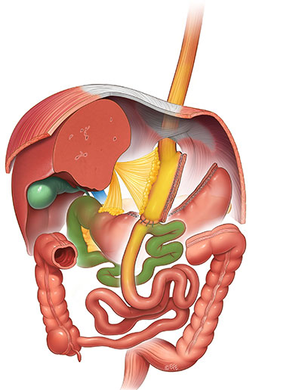
L’inizio
OAGB
(one-anastomosis gastric bypass)
R. Rutledge -1997-

Slide 2
SADI
(OAGB)
SAGI
SADI-S
150-200 cm
300 cm
2-300 cm
WL ++
CoMorb. ++
WL ++
CoMorb. ++
WL +++
CoMorb. +++
Pylorus preserving
Gastric Switch
Malabsorption
Gastric Switch
Taylored Malabsorption
Gastric Switch
Common channel
2-300 cm
??? cm
300 cm
# More demanding technique
The YES’
Duodenal exclusion
(DM remission)
# Primary vs Revisional procedures:
Different results
The NO’s
-Long term f.up -RCT
-No global experience
# Chronic diarrhea/d. syndrome 12.82%
(Cirera,Vilallonga 2021)
# Severe nutritional complications 6.4%
(Vilallonga 2021)

